Slide 1
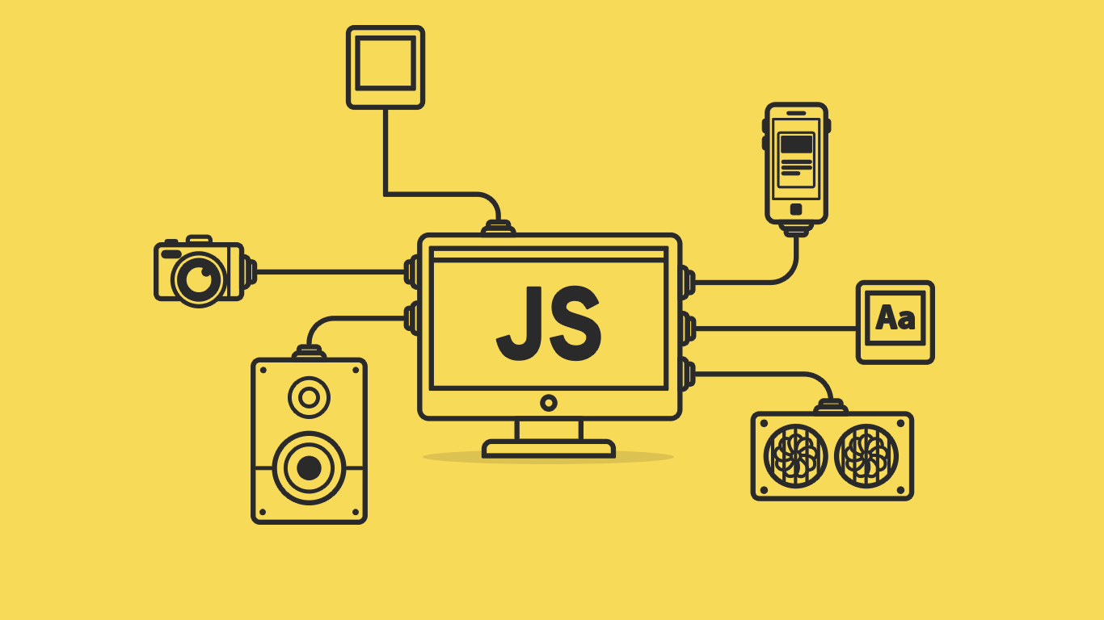
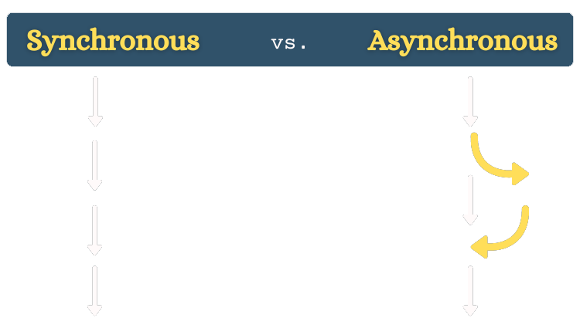

Slide 2
About today…
JavaScript
Async
Callbacks
Avoid callback hell

Slide 3
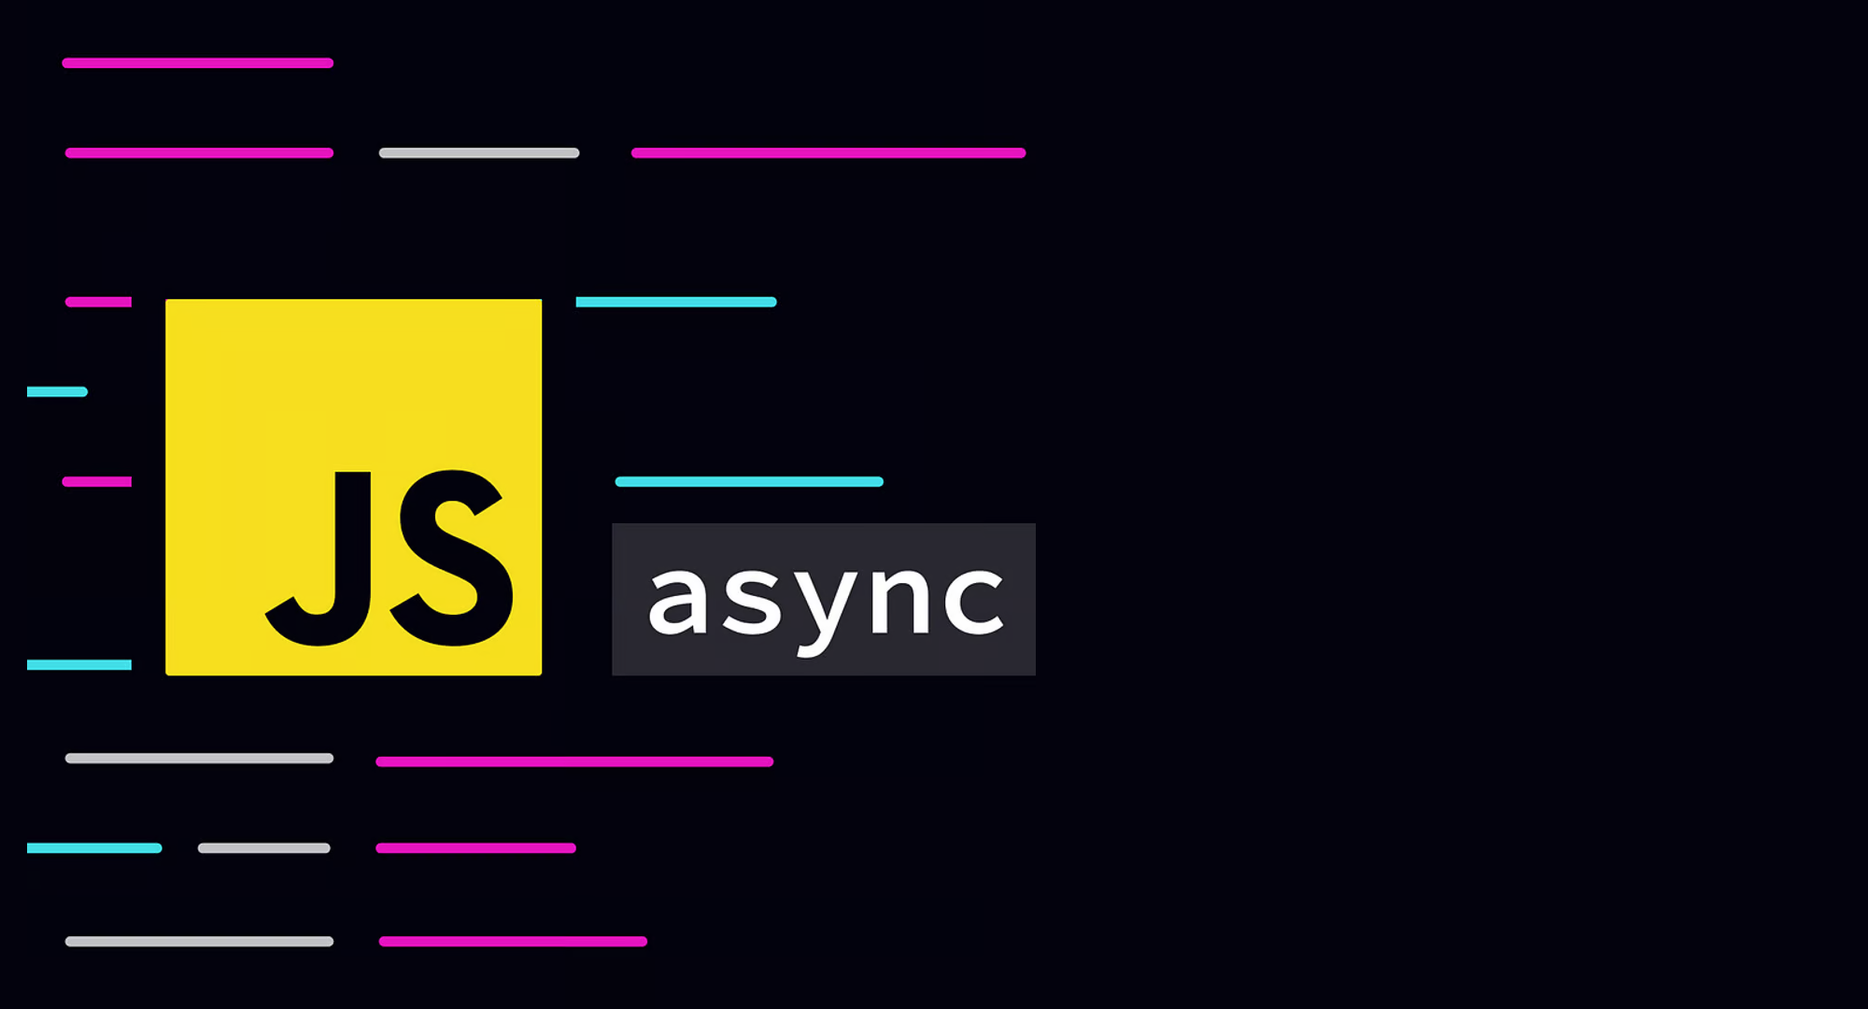

Slide 4

Intro to Asynchronous JavaScript
Intro
JavaScript is single-threaded but can handle tasks asynchronously
Asynchronous operations allow JavaScript to perform tasks without blocking the main thread

Slide 5
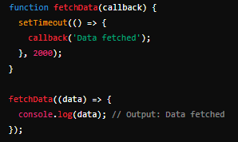
Understanding Callbacks
Intro
A callback is a function passed into another function as an argument, which is then executed after some operation completes
Callbacks help in handling tasks like I/O operations, API requests, and timers

Slide 6

The Need for Callbacks
Handle asynchronous tasks (e.g., data fetching, event handling)
Avoid blocking the main thread, improving performance and responsiveness

Slide 7
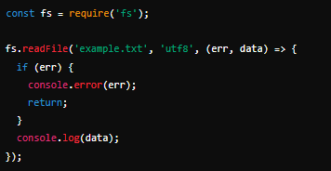
Example of Callbacks in JavaScript
Reading a File Asynchronously

Slide 8
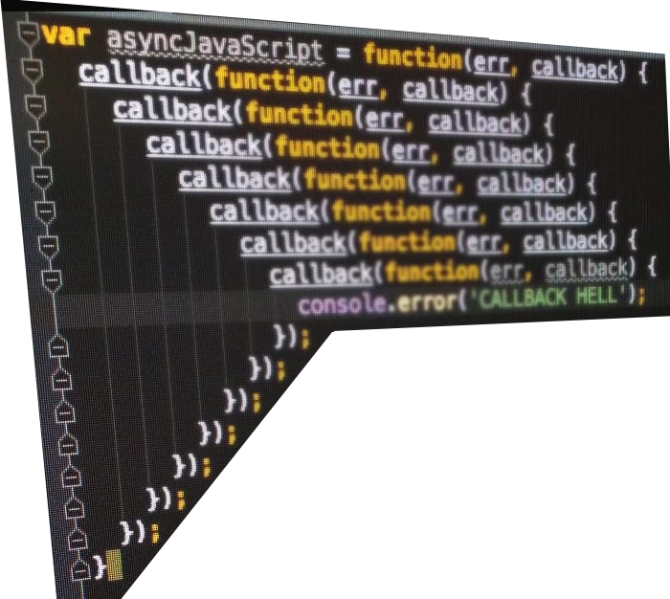

Callback Hell
Nesting multiple callbacks can make code hard to read and
maintain
Often leads to a pyramid-like structure known as "Callback Hell."

Slide 9
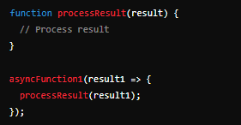
Avoiding Callback Hell
Modularize code: Break down tasks into smaller functions
Use named functions for callbacks to improve readability
Explore alternative approaches like Promises and Async/Await
Example Code
Modular approach

Slide 10

Transition to Promises
Promises provide a cleaner and more manageable way to handle asynchronous operations
Introduces the concept of chaining and error handling

Slide 11

What is a callback function in JavaScript?
A function passed into another function as an argument, which is then executed after some operation completes
Why are callbacks important in JavaScript?
They allow handling of asynchronous operations, ensuring that code does not block the execution of other operations
What is "callback hell"?
A situation where multiple nested callbacks make code difficult to read and maintain, often resembling a pyramid structure
How can you avoid callback hell?
By modularizing code, using named functions for callbacks, and considering alternative approaches like Promises or Async/Await

Slide 12
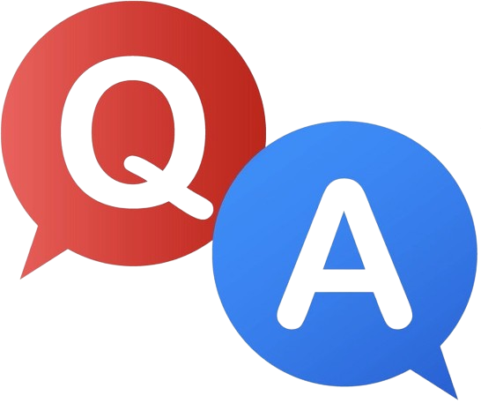

Slide 13

Task 1
Read the contents of a file asynchronously using callbacks in Node.js

